Slide 1
Yushan – Home of Stories
A Webnovel Reading Platform with Gamification
Module: Designing Modern Software Systems – Practice Project

Slide 2
Project Introduction: Yushan – Home of Stories
Overview: Yushan is a web-novel reading platform that combines storytelling with gamification and interactive community engagement.
Problem Statement: Existing storytelling platforms (e.g., Webnovel, Wattpad, Amazon Kindle) lack:
Reward-based engagement
Two-way interaction between readers and authors
Our Goal: Build a unified platform where users can read, write, and be rewarded, blending literary creativity with gamified experiences.
Core Features:
Read and publish webnovels
Earn points, achievements, and badges through engagement
Community discussions and author-reader feedback
Seamless web experience with responsive
UI Tech Stack Overview: • ReactJS • Java Springboot • Supabase • Railway • Upstash • Jest • Jacoco

Slide 3
Agile Project Management & Team Roles
Methodology: Followed Agile Scrum with all standard ceremonies and artifacts documented on JIRA.
Key Ceremonies & Cadence:
Sprint 0: Setup & Refinement (4–8 Sept 2025)
Sprints 1–3: Two-week sprints (Sept–Oct 2025)
Daily Stand-ups: 15-min check-ins every morning
Sprint Review & Retrospective: Thurs–Fri of each sprint’s 2nd week
After Sprint 3: Transitioned to Kanban board for continuous improvements
Agile Deliverables: User Stories, Product Backlog, Sprint Backlog Burndown Charts, Velocity Tracking, Retrospective Notes

Slide 4
Team Roles & Contributions:
Ahan Jaiswal: Developed Yushan-Frontend, Developed Yushan-Backend and Developed Yushan Admin alone, acted as Product Owner/Manager and Scrum Master, performed QA + Performance/Load/API/DB and other testing, created CICD Pipeline for Yushan Admin, wrote tests for Yushan Admin / BE and responsible for Monitoring & Observability Aspects.
Nguyen Phu Truong: Developed Yushan Backend, Created CICD Pipeline for Yushan-Backend & Frontend, Responsible for Deployed on Railway and DB setup on Supabase along with Monitoring & Observability Aspects.
Yang Shuang: Developed Yushan Frontend, wrote Unit Test Cases for both Yushan Frontend and Admin, took Analysis / Product & QA Tasks as well.
Zhu Yuhui: Developed Yushan Frontend and writes unit test cases for it, took analysis and product + QA tasks on the frontend, manual and UI/UX Testing.
Zhang Yan: Developed Yushan Backend and the critical User Service with Mail Util, wrote Unit Test Cases for Yushan Backend, and took active part in Database Refinements.

Slide 5
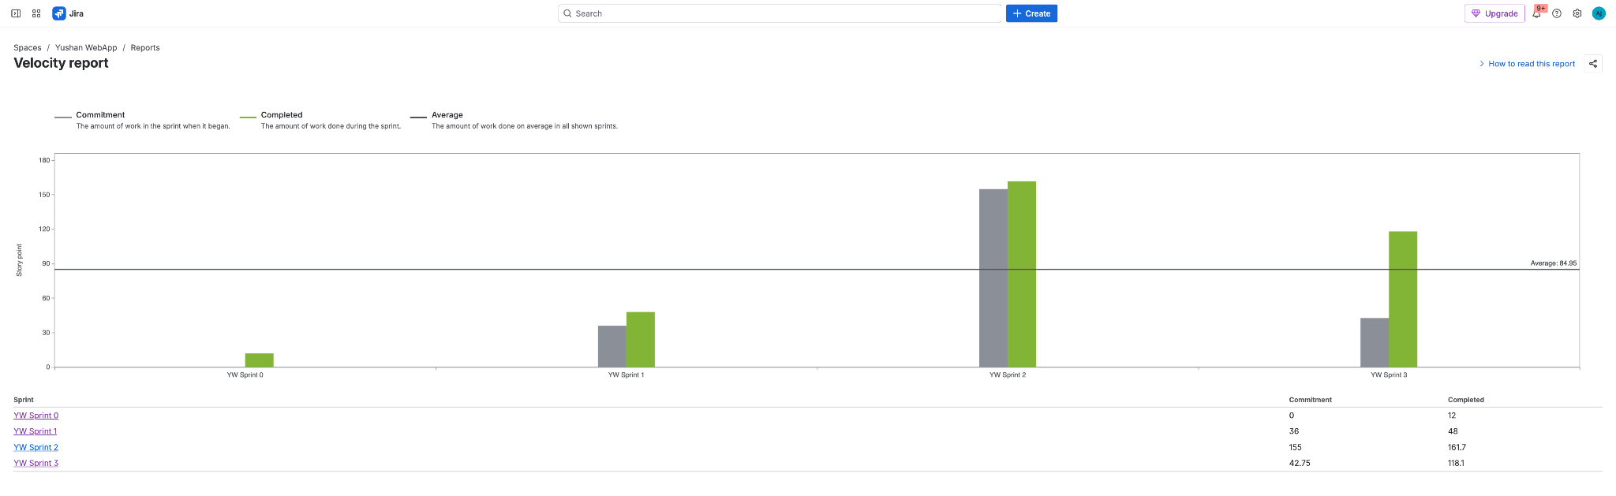
Agile Deliverables and Team Velocity
As you can see, we followed solid Agile practices and incrementally delivered on our committed tasks before start any sprint.

Slide 6
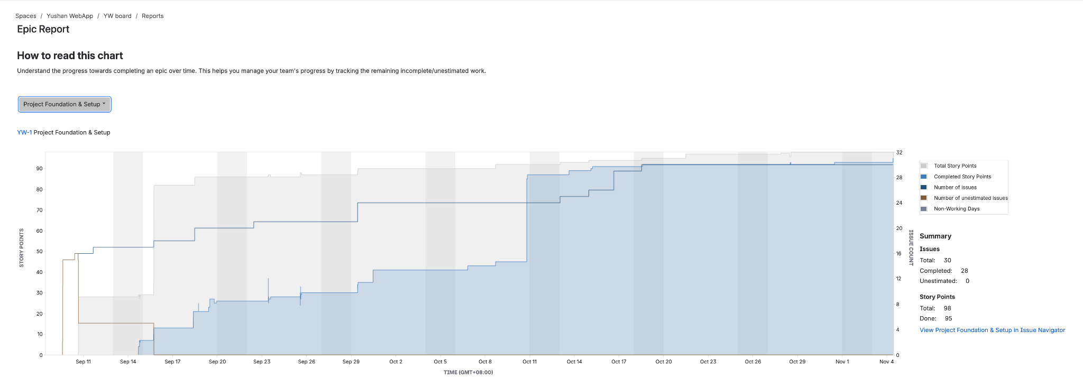
EPIC 1 Detailed Reports

Slide 7
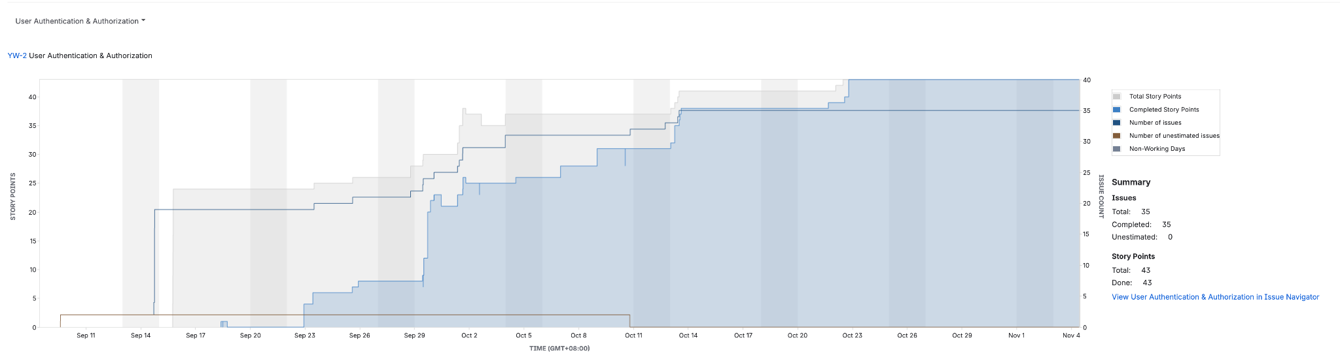
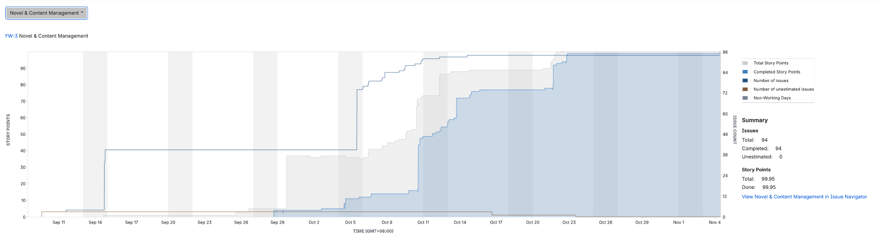
EPIC 2 / 3 Detailed Reports

Slide 8
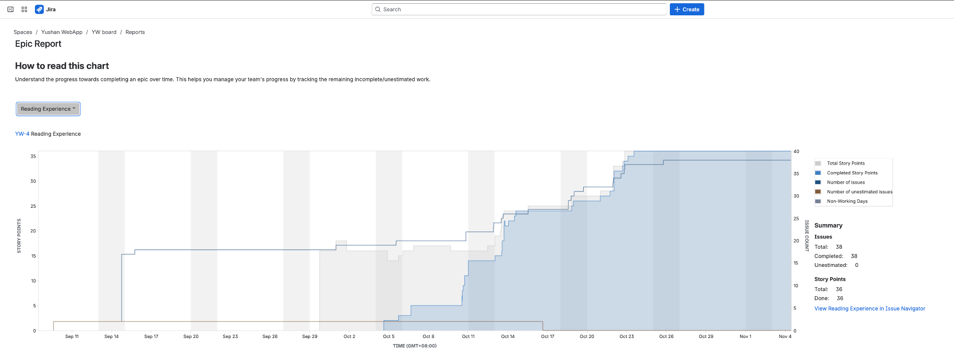
EPIC 4 Detailed Reports

Slide 9
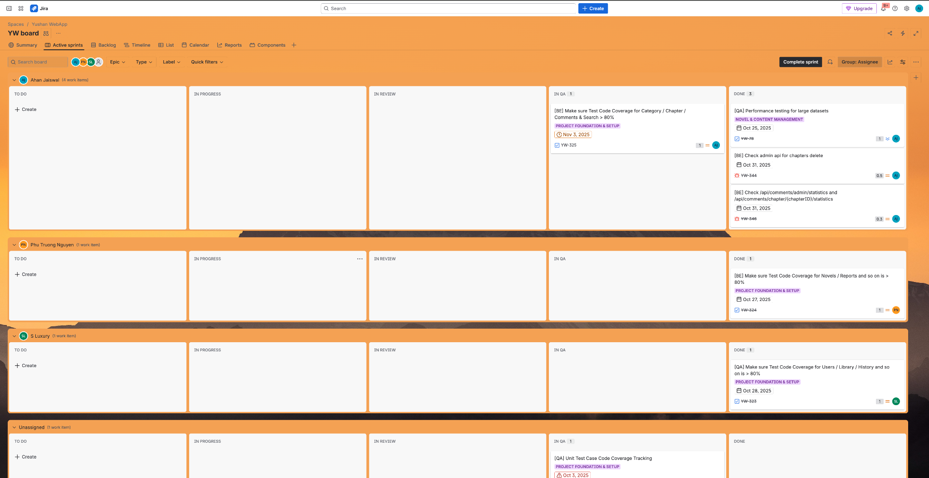
Current Sprint Board Overview

Slide 10
Software Architecture & Design
—— Architectural Decisions, Logical Architecture, Use Case, Analysis and Design Models & Patterns, Database schemas

Slide 11
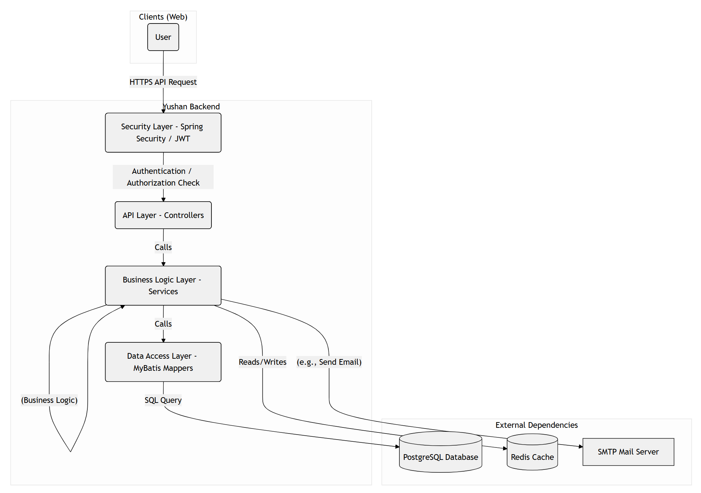
Architecture Overview
flyway

Slide 12
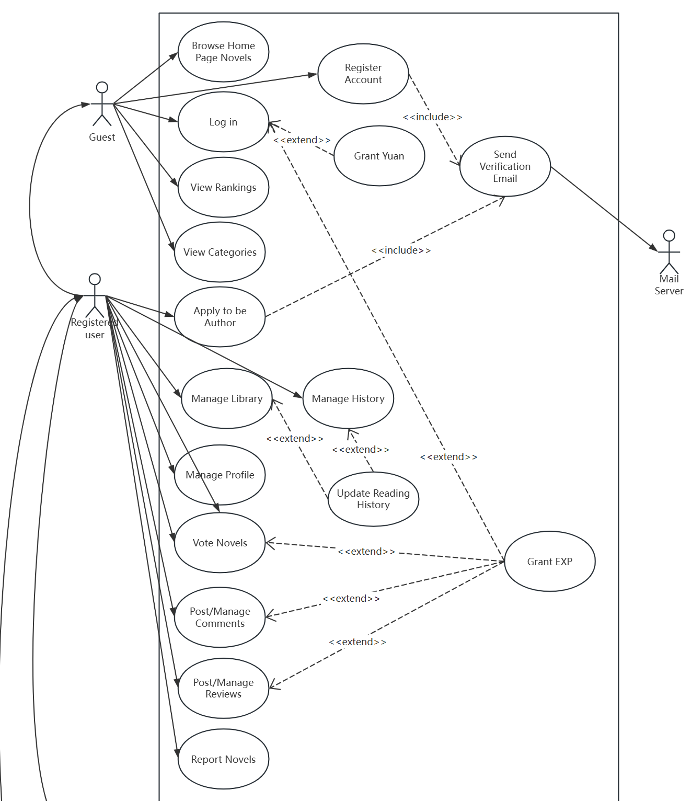
Overall Use Case

Slide 13
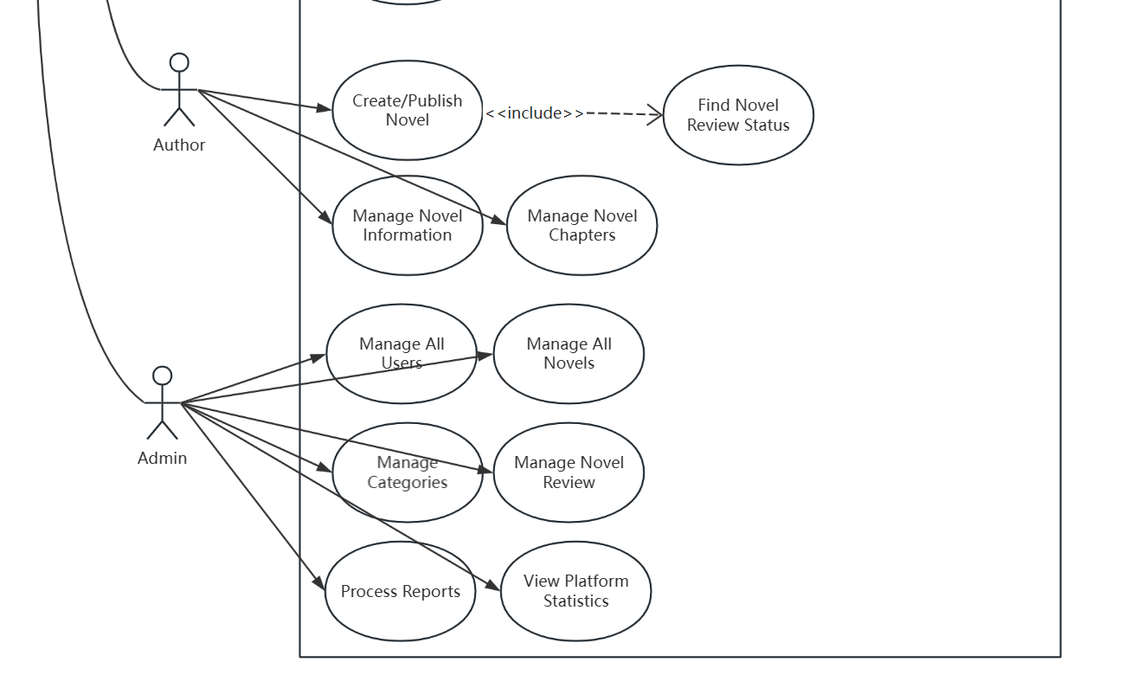
Overall Use Case

Slide 14
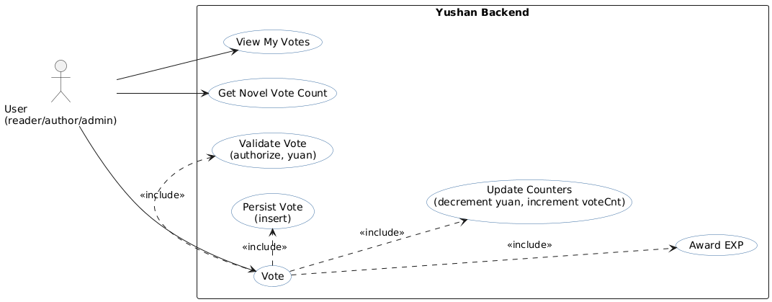
Analysis & Design Models - Use Case Diagram
Use Case: User(reader, writer, admin) votes for a novel
Main flow
User clicks "vote" on a novel.
System validates the action (novel exists, user != this novel’s author, user has >= 1 yuan).
System persists vote record (insert) in Vote table.
System deducts 1 yuan from user and updates user record.
System increments novel.voteCnt (atomic DB update).
System awards EXP to the user.
System returns VoteResponseDTO (novelId, voteCount, remainedYuan).
Alternate flows / exceptions
If user is the author of this novel -> validation fails -> return error "Cannot vote your own novel".
If user has not enough yuan -> validation fails -> return error "Not enough yuan".
If inserting the vote fails due to duplicate key (already voted) -> treat as idempotent or handle as "already voted"
Preconditions
User is authenticated.
Novel exists and is available (published).
Postconditions
On success: vote record exists, user.yuan decreased, novel.voteCnt updated, user.exp increased.
On failure: no DB side effects (transaction rollback).
Notes:
* First, for the use case diagram, we’ve identified these main actions according to product requirements, such as view my votes, get novel vote count and toggle vote.
* Also, we designed the preconditions, and in the main flow the user clicks on vote button, our system validates the action, inserts a vote record, deducts one yuan, increments novel.voteCnt, and awards EXP.
* And then, we’ve also considered two postconditions, success and failure, and designed the alternate flows and exceptions for them.

Slide 15
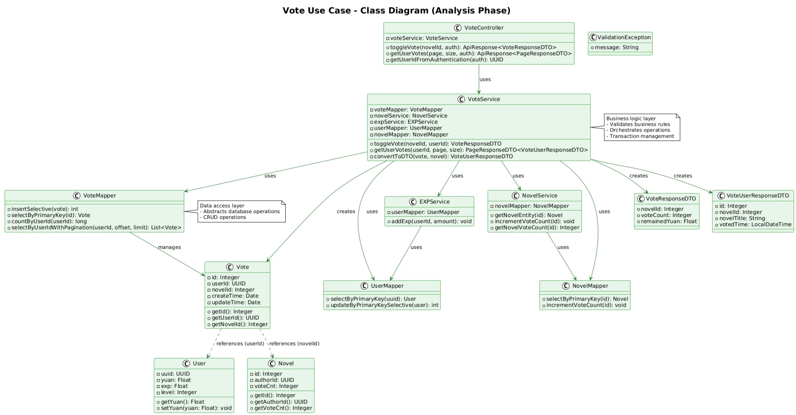
Analysis & Design Models - Class Diagram
Use Case: User(reader, writer, admin) votes for a novel
Notes:
* At the top is VoteController with methods like toggleVote and getUserVotes.
* The central component is VoteService, which uses VoteMapper, NovelService, EXPService, UserMapper, and NovelMapper. These Mappers provide CRUD methods such as incrementVoteCount. And related DTOs are created by the VoteService.
* Also, we design domain classes like Vote, User, and Novel with related fields.

Slide 16
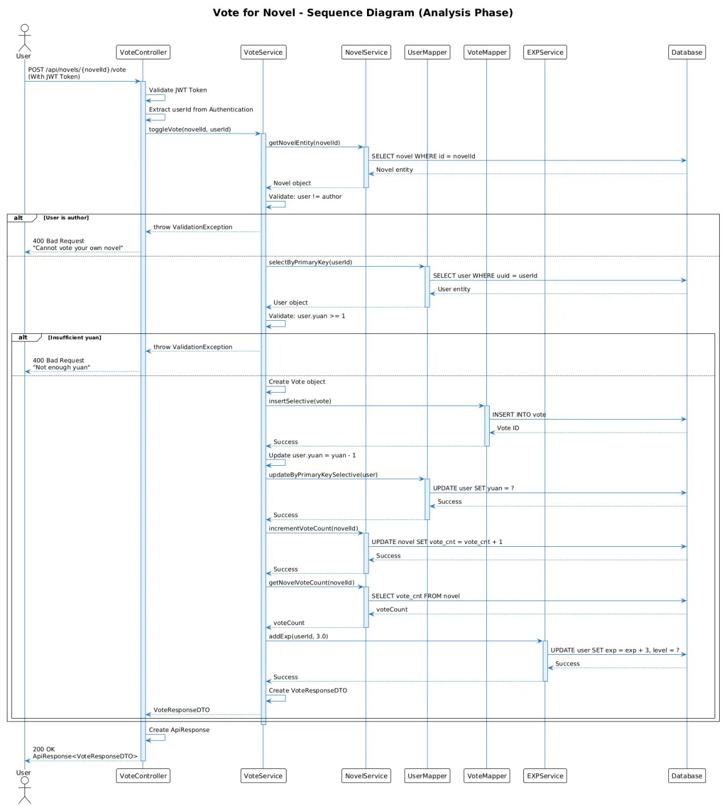
Analysis & Design Models - Sequence Diagram
Use Case: User(reader, writer, admin) votes for a novel
Notes:
* Next, I‘ll show the runtime flow in the sequence diagram.
* First, the frontend calls Vote API with a JWT token to VoteController, and the controller validates the token, extracts the user id, and calls VoteService.toggleVote.
* Next, the service loads the novel and user, then validates user role and user.yuan.
* If validation passes, the service inserts a vote, deducts one yuan from the user, increments novel.voteCnt, fetches the new voteCount, calls EXPService.addExp, and builds VoteResponseDTO.
* If validation fails, a ValidationException is thrown and a 400 Bad Request is returned. This makes the exact order and error branches clear.

Slide 17
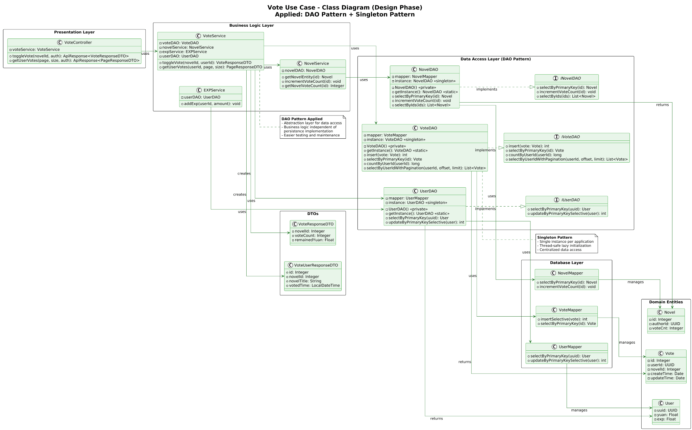
Design Problems & Patterns - Class Diagram
Use Case: User(reader, writer, admin) votes for a novel
Notes:
* This design class diagram shows the concrete patterns we applied and why.
* We use DAO interfaces to isolate persistence and singleton instances to centralize access; that reduces repeated initialization and clarifies ownership of mappers. These patterns improve maintainability and make it easier to swap persistence implementations.
* However, singletons can complicate unit testing and tight coupling — to address that we keep DAO interfaces so tests can inject mocks, and in a Spring backend these DAOs should be managed beans rather than manual singletons.
* Lastly, the design preserves a single transaction in VoteService to ensure all-or-nothing behavior.
* These choices trade a bit of implementation complexity for correctness, scalability, and easier testing.

Slide 18
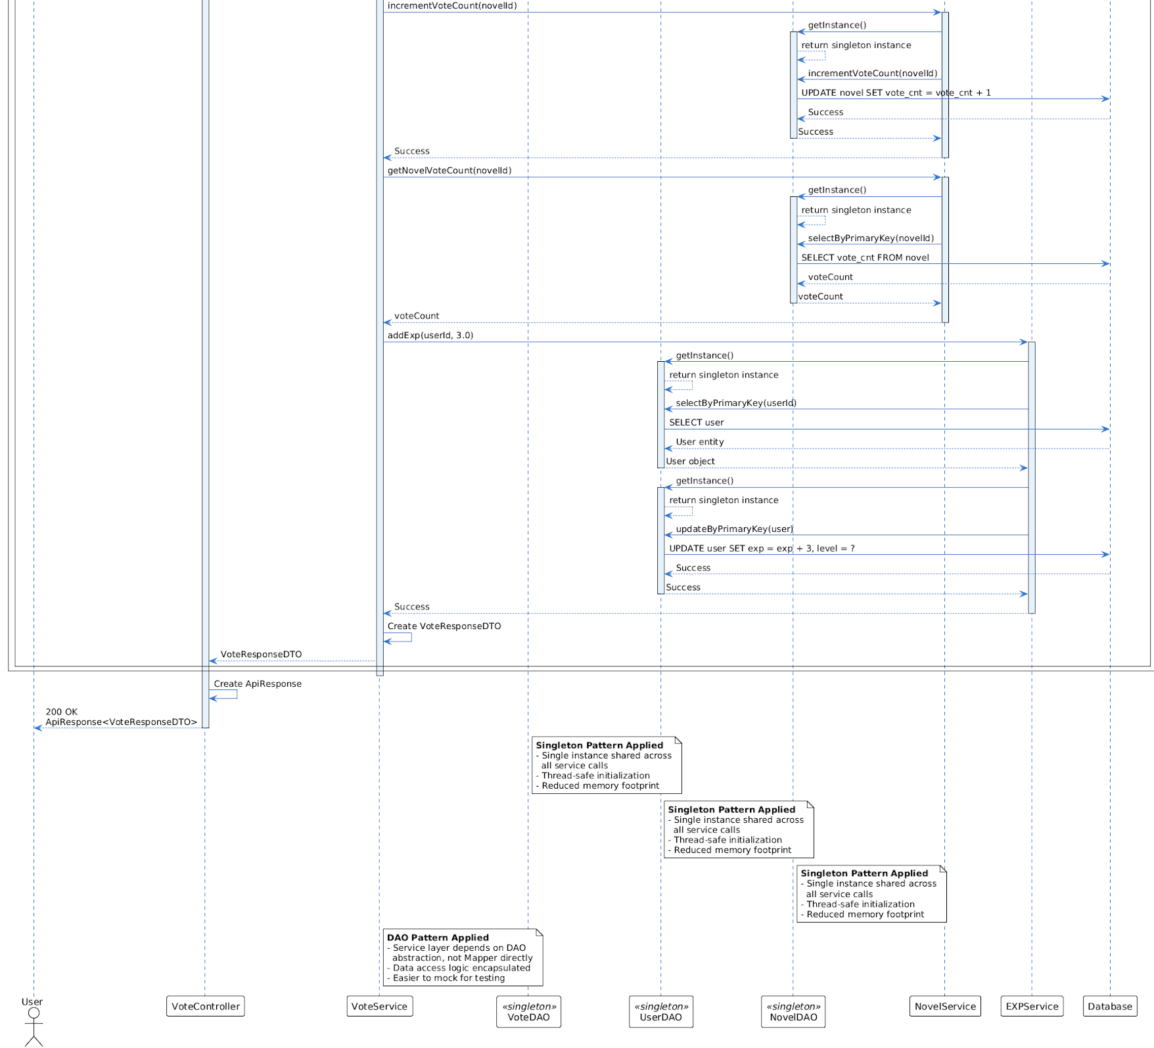
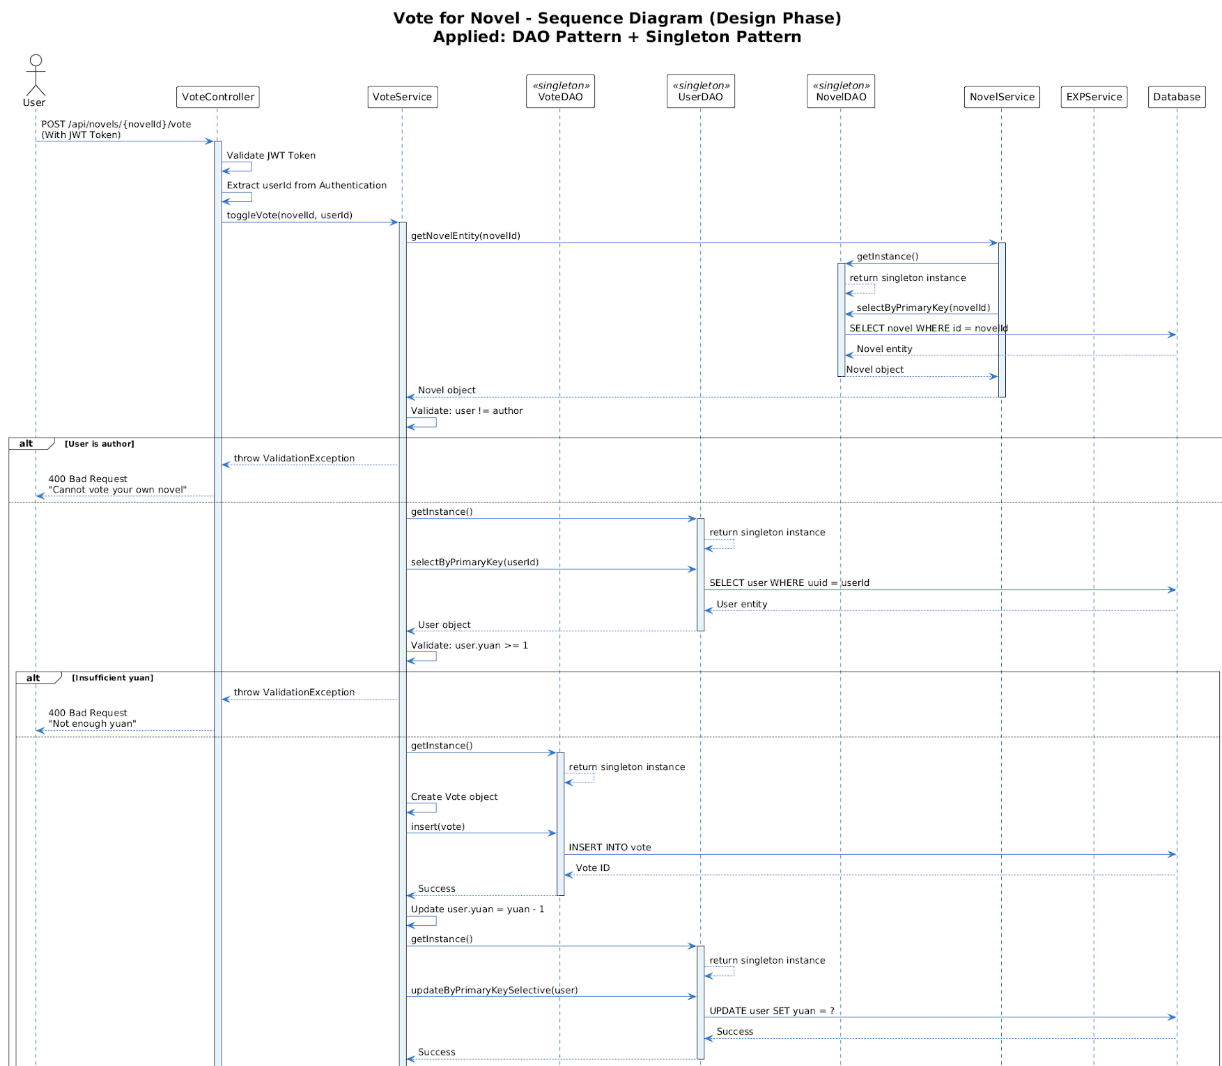
Design Problems & Patterns - Sequence Diagram
Use Case: User(reader, writer, admin) votes for a novel
Notes:
* For the sequence design, we kept the original vote flow but clearly addressed key design problems.
* First, persistence is separated into DAO singletons so the service no longer mixes SQL with business logic, which improves testability and keeps VoteService focused on orchestration and transactions.
* Second, we made the data access calls explicit: insert(vote), update user yuan, and atomic incrementVoteCount at the DB level. This fixes the concurrency issue from the analysis phase by moving the vote count increment into a single DB statement.
* Finally, we handle idempotency by relying on a unique constraint on (userId, novelId) and treating duplicate-key errors as safe no-ops; this prevents double-charging the user.

Slide 19
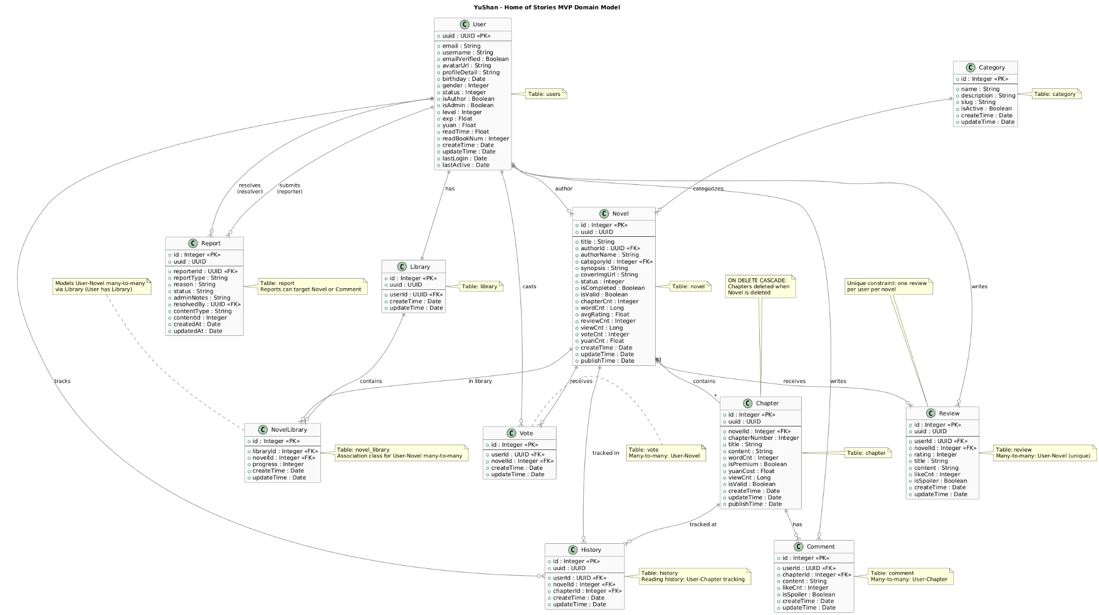
Database schemas
Notes:
Last, for our database schema, we use PostgreSQL as a relational database, and our design follows third normal form (3NF) to reduce data redundancy. We also use Flyway for database version control to keep schema consistent across environments.
This is our entity relationship diagram. It shows main tables: User, Novel, Chapter, Vote, Review, Comment, History, NovelLibrary, and Category.
User table stores profile and yuan balance, use UUID as the primary key, which helps distributed scaling and hides sequential IDs.
Novel stores metadata and counters like voteCnt and viewCnt. Chapter links to Novel, which are deleted when a novel is deleted. Also, we denormalize vote_cnt and view_cnt in the novel table to avoid costly aggregation on read, this trades space for faster queries.
And then, vote links User and Novel. We enforce one vote per user per novel. Review also has one review per user per novel. All tables have createTime and updateTime for audit, and foreign keys keep data consistent.

Slide 20
Types of Testing Conducted

Slide 21
Comprehensive Testing Strategy
There are many types of testing for web applications, each serving different purposes. Here are the main categories that we have implemented in Yushan:
Functional Testing Aspects (we also did Manual Testing as a whole team) -
Unit Testing: Testing individual components or functions in isolation
Integration Testing: Testing how different modules work together
System Testing: Testing the complete application as a whole
Smoke Testing: Quick tests to verify basic functionality works
Sanity Testing: Focused testing after minor changes
Regression Testing: Ensuring new changes don't break existing features

Slide 22
Non-Functional Testing Strategy
Performance Testing: How the application performs under load
Load Testing: behavior under expected load
Stress Testing: behavior under extreme conditions
Spike Testing: sudden traffic increases
Endurance Testing: sustained load over time
Security Testing: Identifying vulnerabilities (SQL injection, XSS, CSRF, etc.)
Usability Testing: How easy and intuitive the application is to use
Compatibility Testing: Testing across different browsers, devices, and OS
https://maugus0.github.io/yushan-frontend/
https://maugus0.github.io/yushan-admin/admin/login

Slide 23
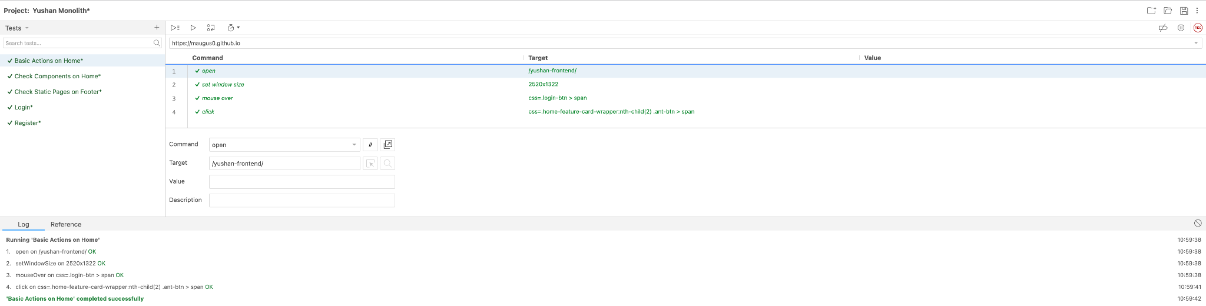
Used Selenium for UI/UX Automated Testing Flows -
We’ve used Selenium IDE Plugin to automate some basic UI/UX Flows.
However, since we used Antd Framework on Frontend.
We need to create manual Scripts for more complicated User Flows.

Slide 24
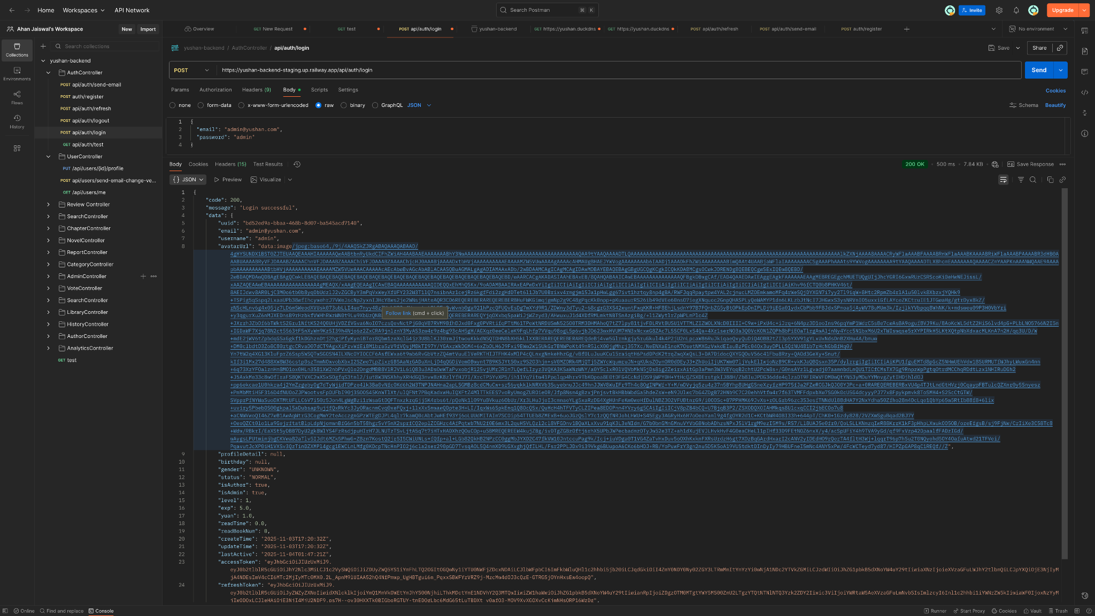
Screenshot of Postman API Collection for Testing:

Slide 25
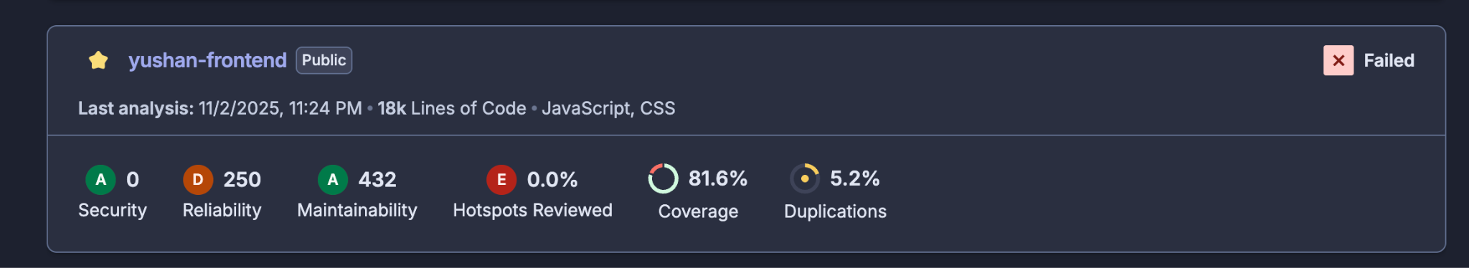
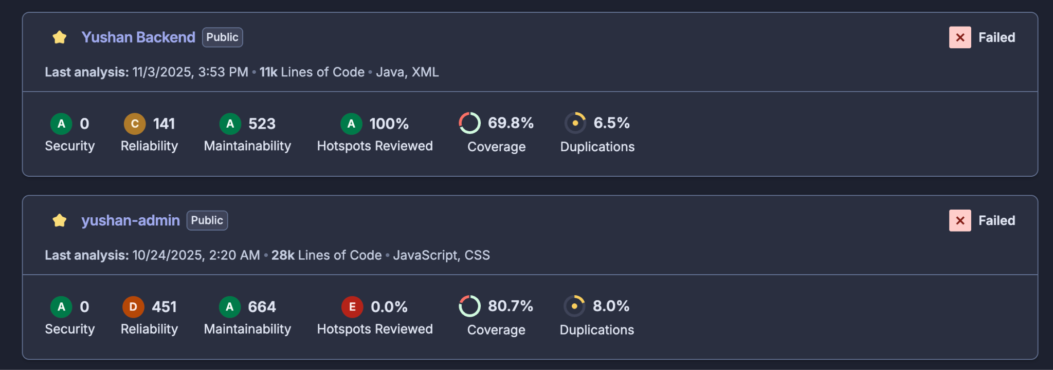
Other Important Testing Strategies
API Testing: Testing backend endpoints and data exchange
Database Testing: Validating data integrity and database operations
UI/Visual Testing: Ensuring the interface displays correctly
End-to-End (E2E): Testing complete user workflows from start to finish
A/B Testing: Comparing different versions to see which performs better
Exploratory Testing: Unscripted testing to discover unexpected issues
Mobile Testing: Testing responsive design and mobile-specific features

Slide 26
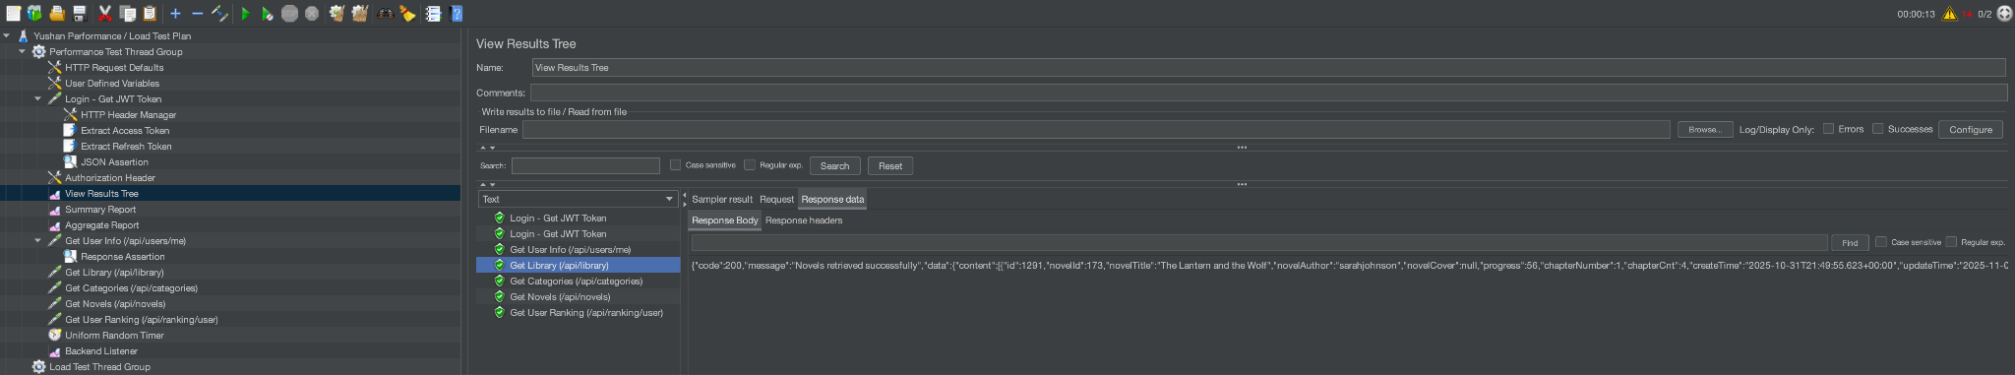
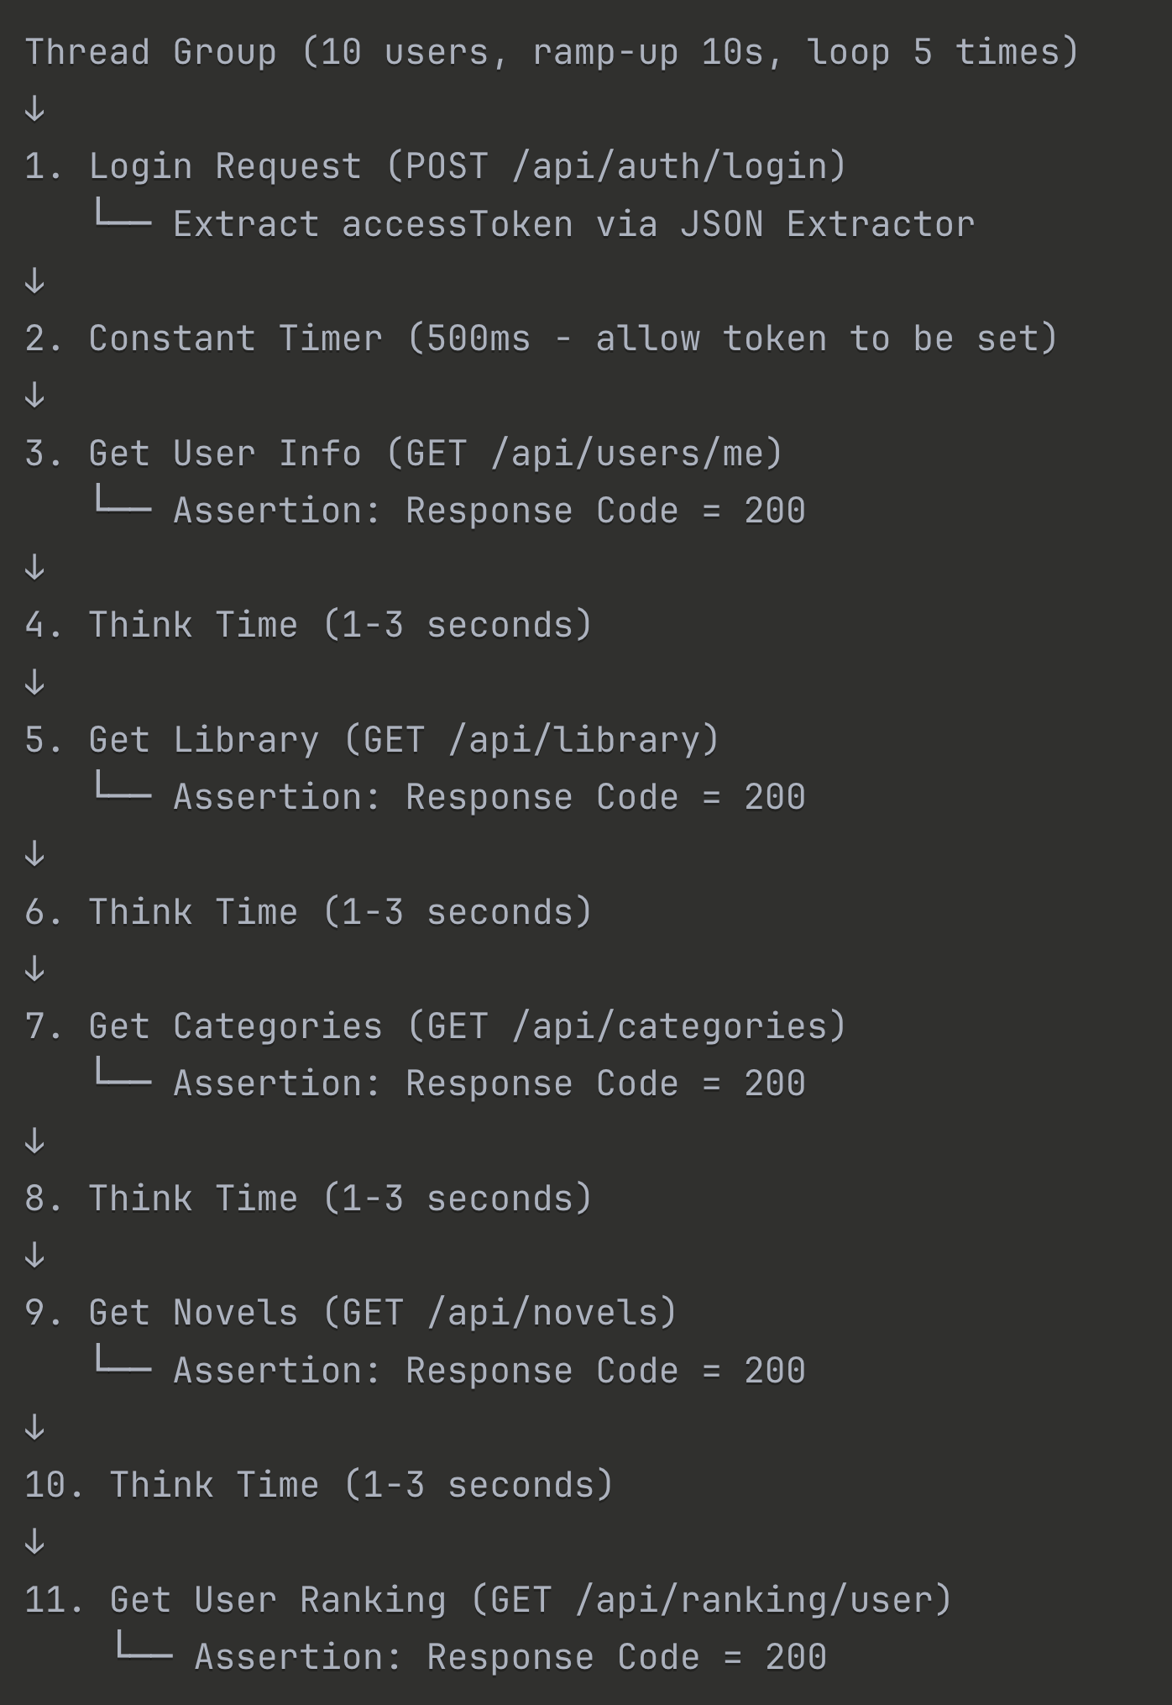
Performance / Load Tests with Jmeter
This simulates a realistic user journey:
User logs in
Checks their profile
Views their library
Browses categories
Searches for novels
Checks user rankings

Slide 27
DevOps and Development Lifecycle

Slide 28
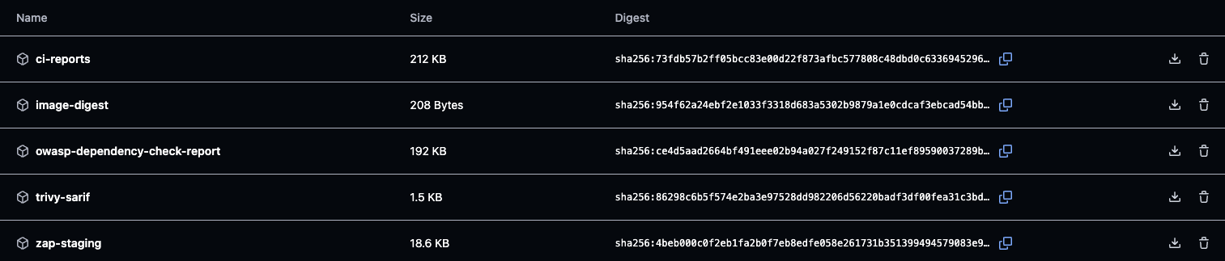
1. Repository Structure: yushan-backend & yushan-frontend
2. Artifact Management
Container Image Registry: GitHub Container Registry
Location: ghcr.io/maugus0/yushan-*
Multi-Platform Build:
Platforms: linux/amd64, linux/arm64
Push strategy: Push once, pull by platform
Cache: GitHub Actions cache for faster builds
GitHub Actions artifacts

Slide 29
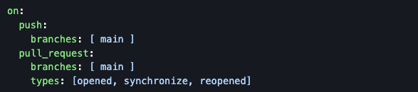
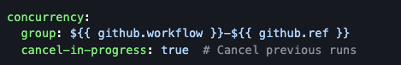
3. DevOps Pipeline & Procedures
Workflow File: .github/workflows/maven.yml in each repository
Runner: ubuntu-latest (GitHub-hosted)
Trigger:
Concurrency Control:

Slide 30
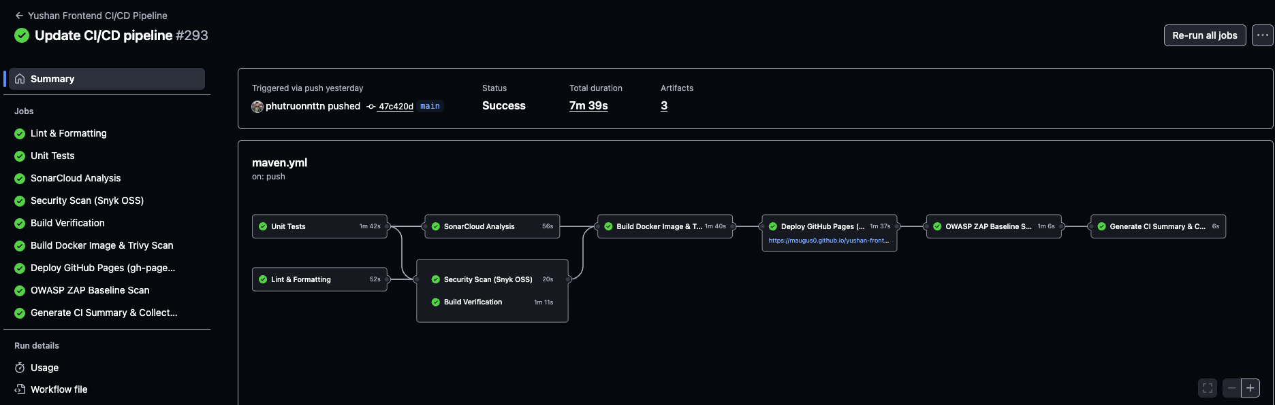
Yushan Frontend CI/CD Pipeline
Test components, functions (Jest, React Testing Library)
Code quality gate (SonarCloud)
Build container image (Docker Buildx, Trivy)
Security scan running app (OWASP ZAP)
Collect all CI reports
Check code style, formatting (Prettier, ESLint)
Find dependency vulnerabilities (Snyk)
Verify production build (npm) -> Build artifacts
Deploy to GitHub Pages (gh-pages CLI, Playwright) - Health check + Auto rollback

Slide 31
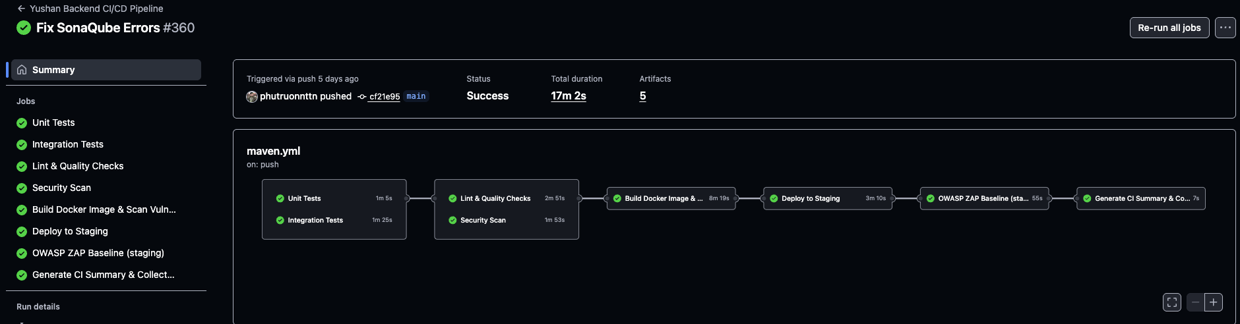
Yushan Backend CI/CD Pipeline
Test business logic in isolation (Maven, JUnit, Mockito)
Check code quality and style (SpotBugs, Checkstyle, JaCoCo, SonarCloud)
Build multi-platform image (Docker Buildx, Trivy)
Deploy to Railway staging and health check
Test with real services (PostgreSQL, Redis)
Find vulnerabilities (OWASP Dependency-Check, Snyk)
Security scan in production (OWASP ZAP)
Aggregate reports (GitHub Actions)

Slide 32
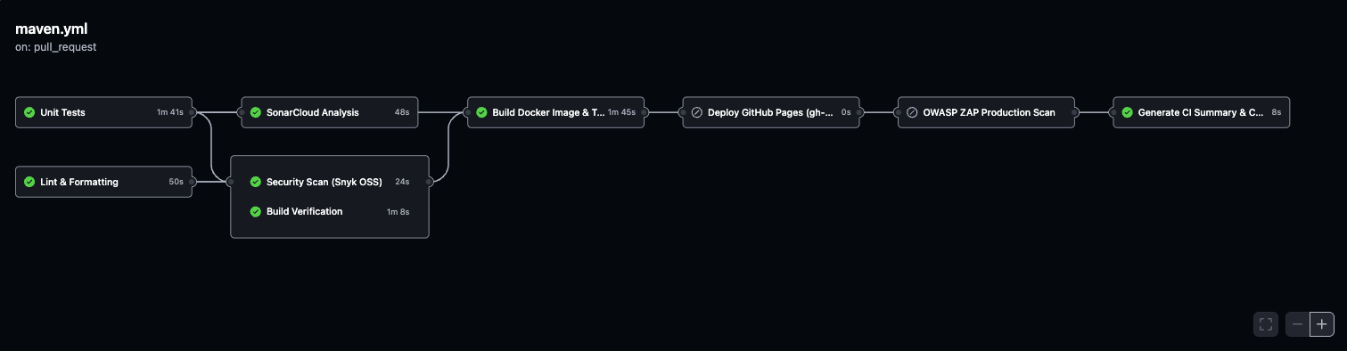
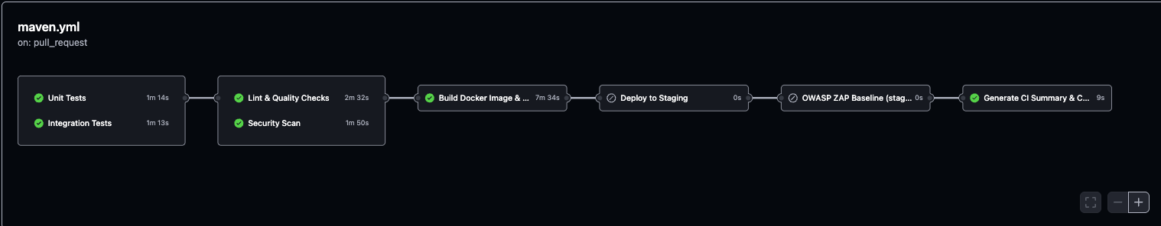
CI/CD Pipeline in Pull Requests

Slide 33
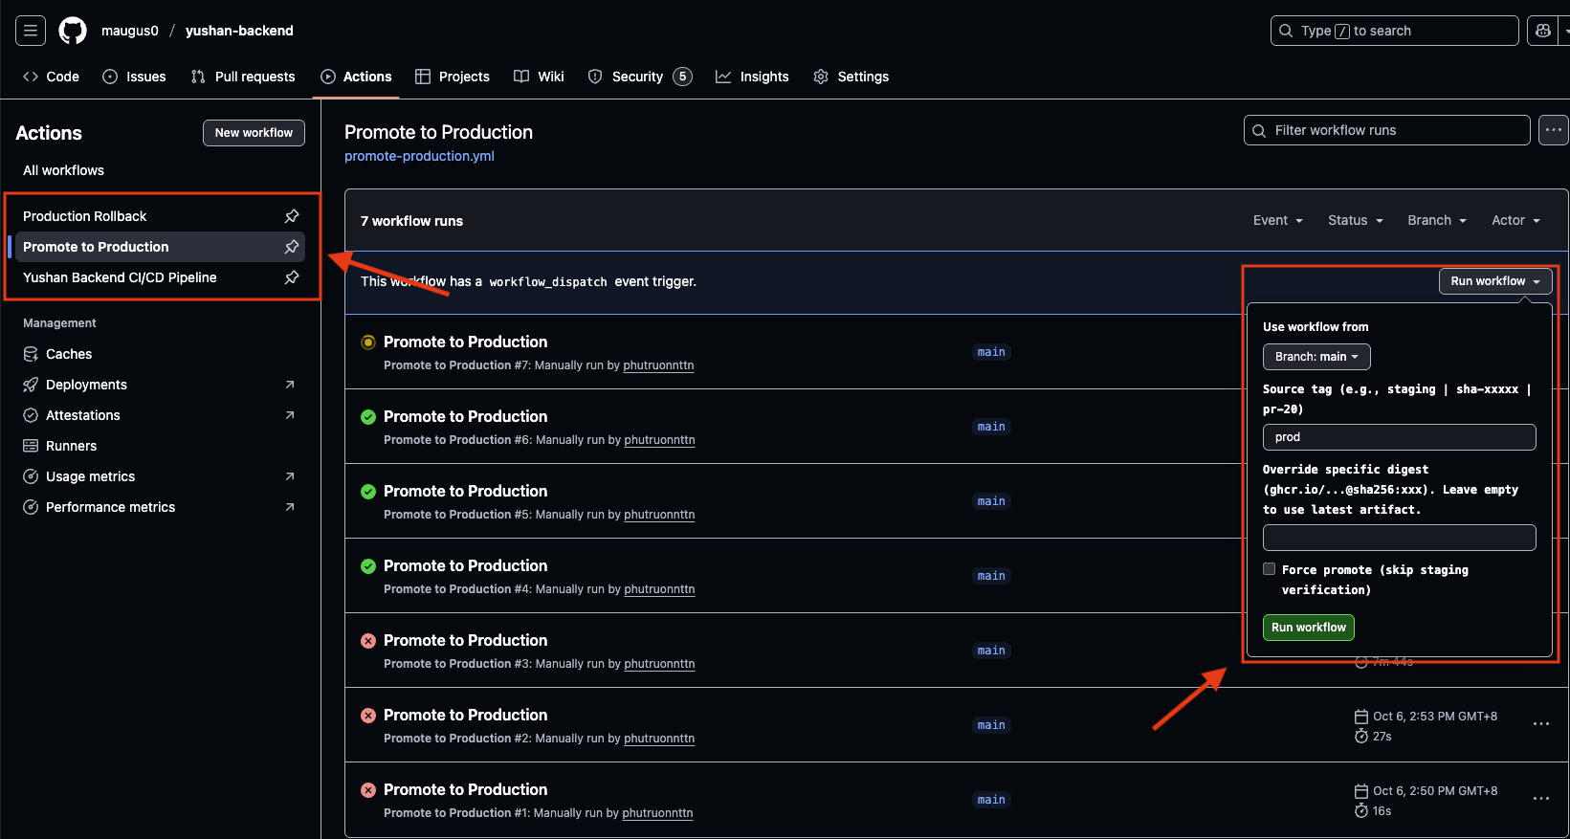
Promote to Production workflow

Slide 34
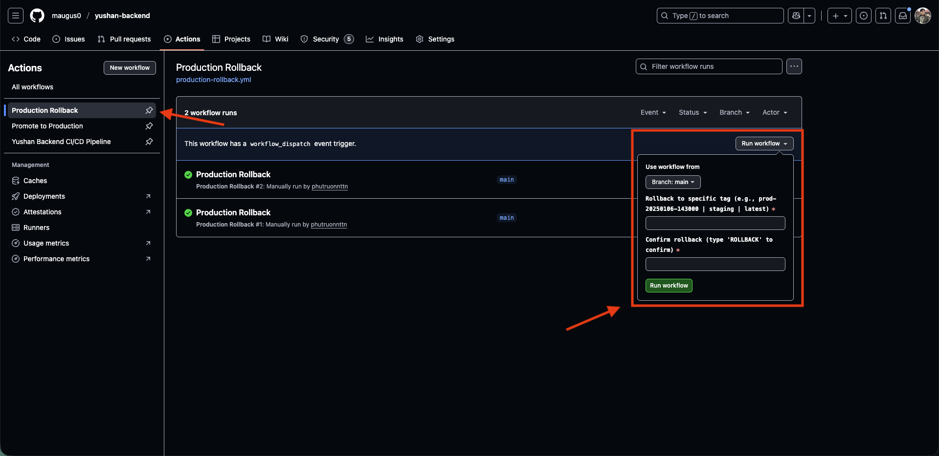
Production Rollback workflow

Slide 35
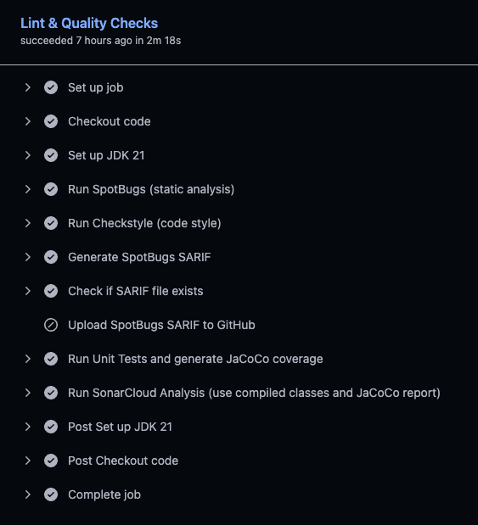
Lint & Quality Checks
SpotBugs: Static analysis for bugs
Exclusions: spotbugs-exclude.xml
Checkstyle: Code style enforcement
Config: checkstyle.xml
Rules: Google Java Style Guide
JaCoCo: Code coverage
Plugin: jacoco-maven-plugin:0.8.11
Coverage report: target/site/jacoco/jacoco.xml
SonarCloud: Quality gate - SAST
Project: maugus0_yushan-backend
Organization: yushan
Uploads to: https://sonarcloud.io
Quality Metrics:
Code Smells: Tracked via SonarCloud
Duplicated Code: < 3%
Test Coverage: > 80% (target)
Vulnerabilities: 0 critical
Notes:
SAST (Static Application Security Testing)
SCA (Software Composition Analysis)
DAST (Dynamic Application Security Testing)

Slide 36
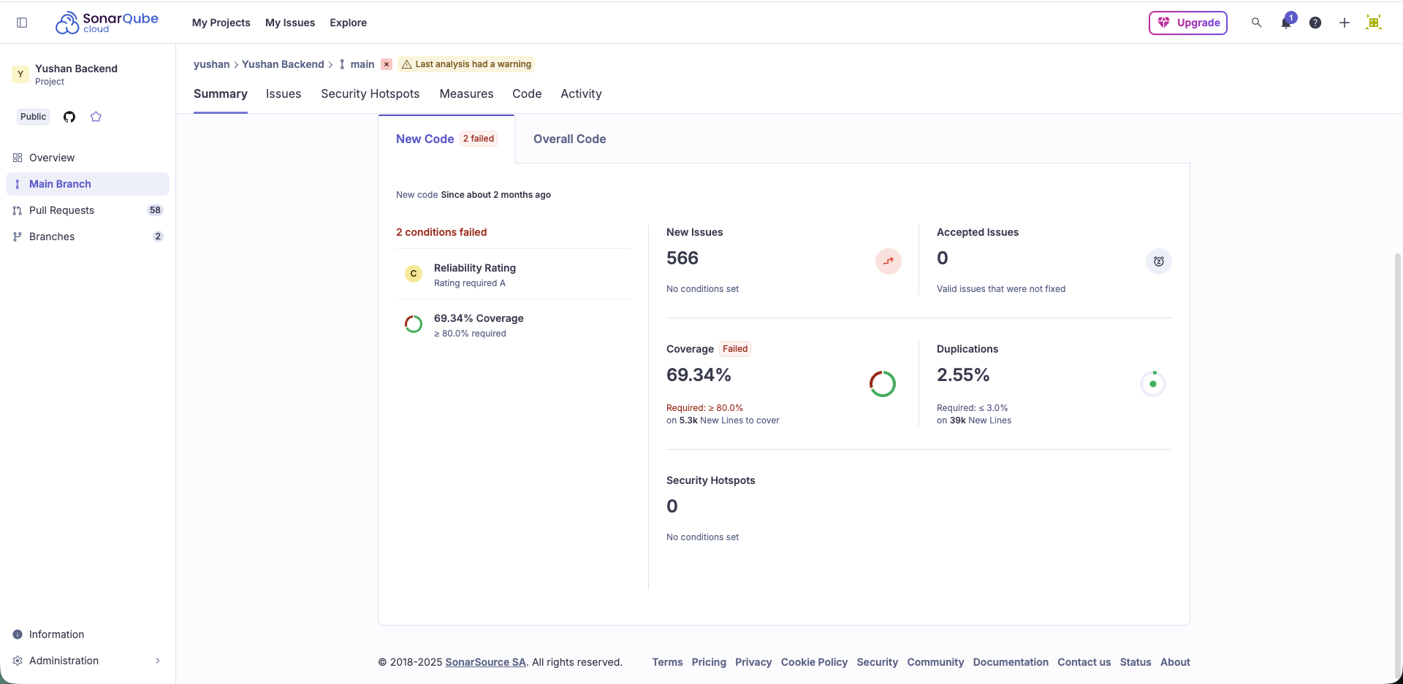
SonarCloud Dashboard

Slide 37
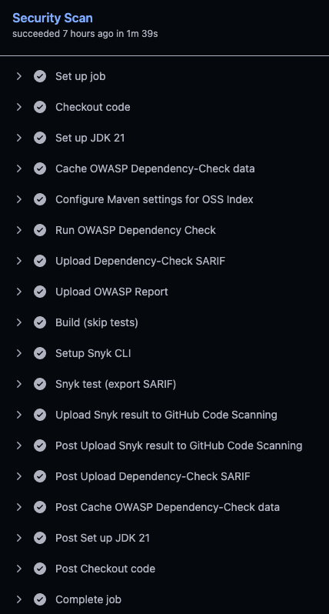
Security Scan
OWASP Dependency Check - SCA
Plugin: dependency-check-maven:12.1.0
NVD API: Scans against National Vulnerability Database
OSS Index: Additional vulnerability database
Output: HTML, XML, SARIF
Fail on: CVSS >= 10 (critical)
Snyk - SCA
Setup: snyk/actions/setup@master
Severity: High+ vulnerabilities
Output: SARIF format
Upload: To GitHub Security tab
Notes:
SAST (Static Application Security Testing)
SCA (Software Composition Analysis)
DAST (Dynamic Application Security Testing)

Slide 38
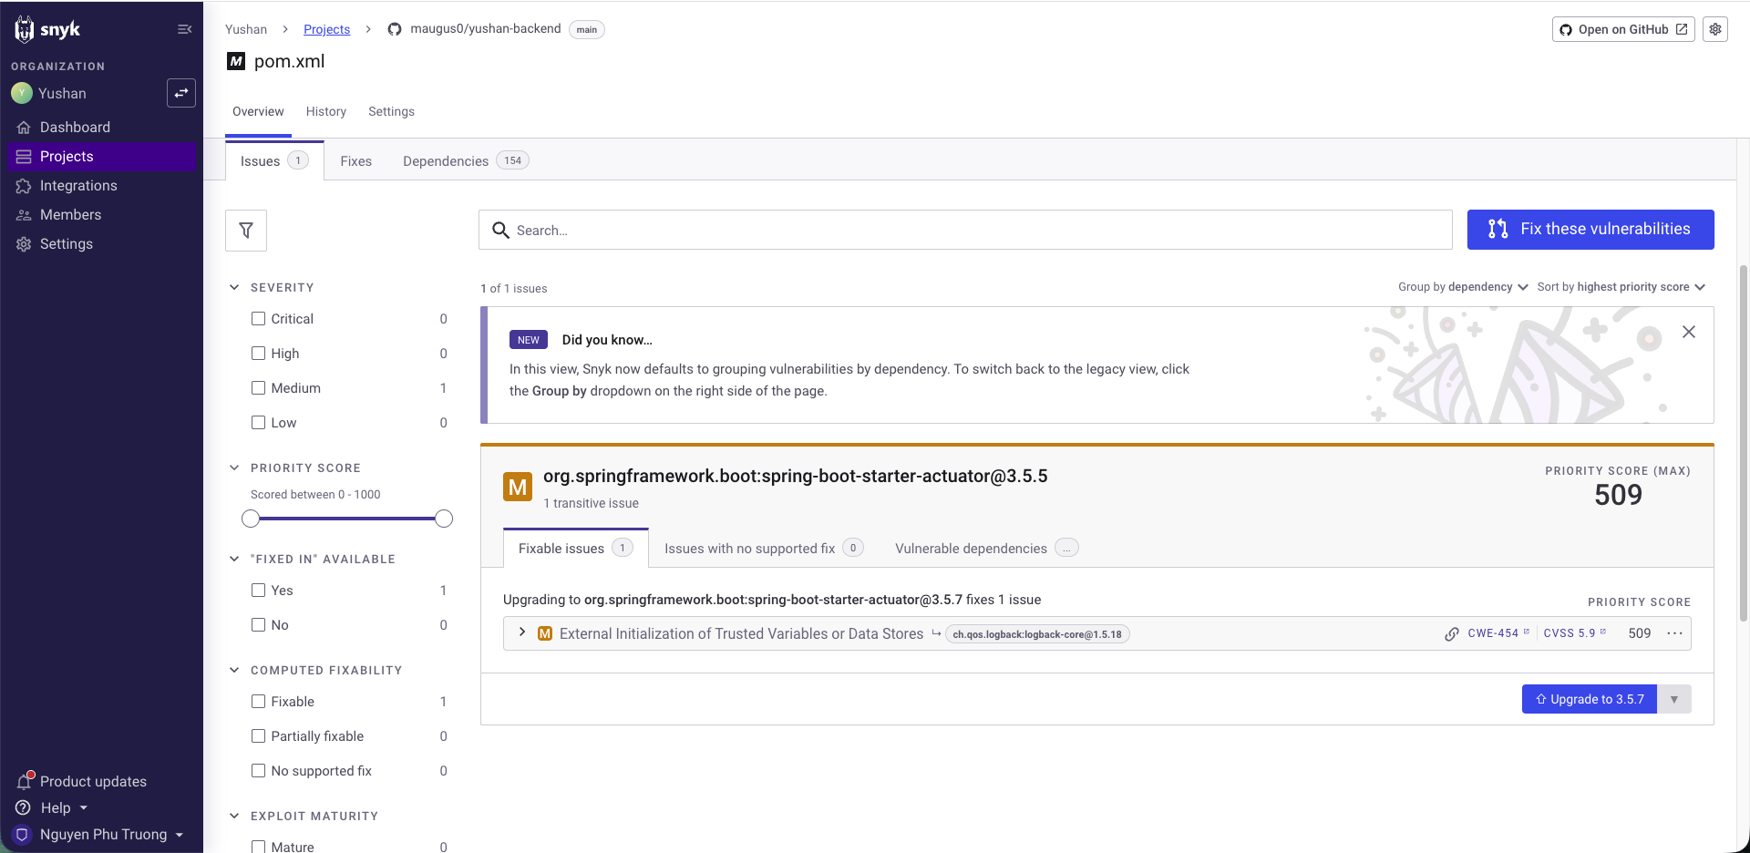
Snyk Dashboard

Slide 39
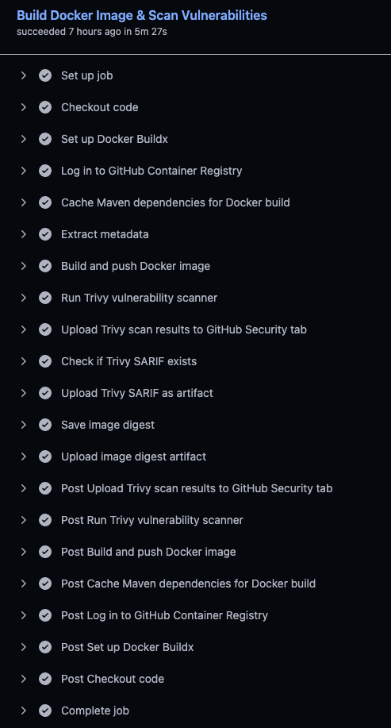
Build Docker Image & Scan Vulnerabilities
Docker Image Details
Base Image: eclipse-temurin:21-jdk-alpine (builder), eclipse-temurin:21-jre-alpine (runtime)
Multi-Stage Build: Reduces size by 70%
Security: Non-root user (appuser, UID 1001)
Health Check: Built-in Docker healthcheck
Size: ~150-200MB (optimized from 500MB+)
Trivy Scanning
Tool: aquasecurity/trivy-action@master
Format: SARIF for GitHub Security tab
Scans: OS packages, application dependencies
Upload: Results uploaded as artifacts
Notes:
SAST (Static Application Security Testing)
SCA (Software Composition Analysis)
DAST (Dynamic Application Security Testing)

Slide 40
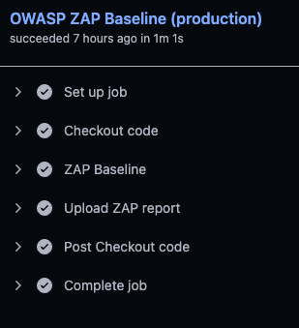
OWASP ZAP Baseline - DAST
What It Tests:
SQL injection vulnerabilities
XSS (Cross-Site Scripting)
Authentication flaws
Security misconfigurations
Notes:
SAST (Static Application Security Testing)
SCA (Software Composition Analysis)
DAST (Dynamic Application Security Testing)

Slide 41
4. Improvements
Docker Build Optimization
Before: Single-stage build, large images (500MB+)
After: Multi-stage build with Alpine Linux
Result: 70% smaller images (150-200MB)
Maven Dependency Caching
Implementation: GitHub Actions cache for .m2/repository
Result: Dependency download reduced from 5 minutes to 1 minute
Test Execution Parallelization
Implementation: Run unit and integration tests in separate jobs instead of sequentially. Same for Lint & Quality Checks and Security Scans
Notes:
SAST (Static Application Security Testing)
SCA (Software Composition Analysis)
DAST (Dynamic Application Security Testing)

Slide 42
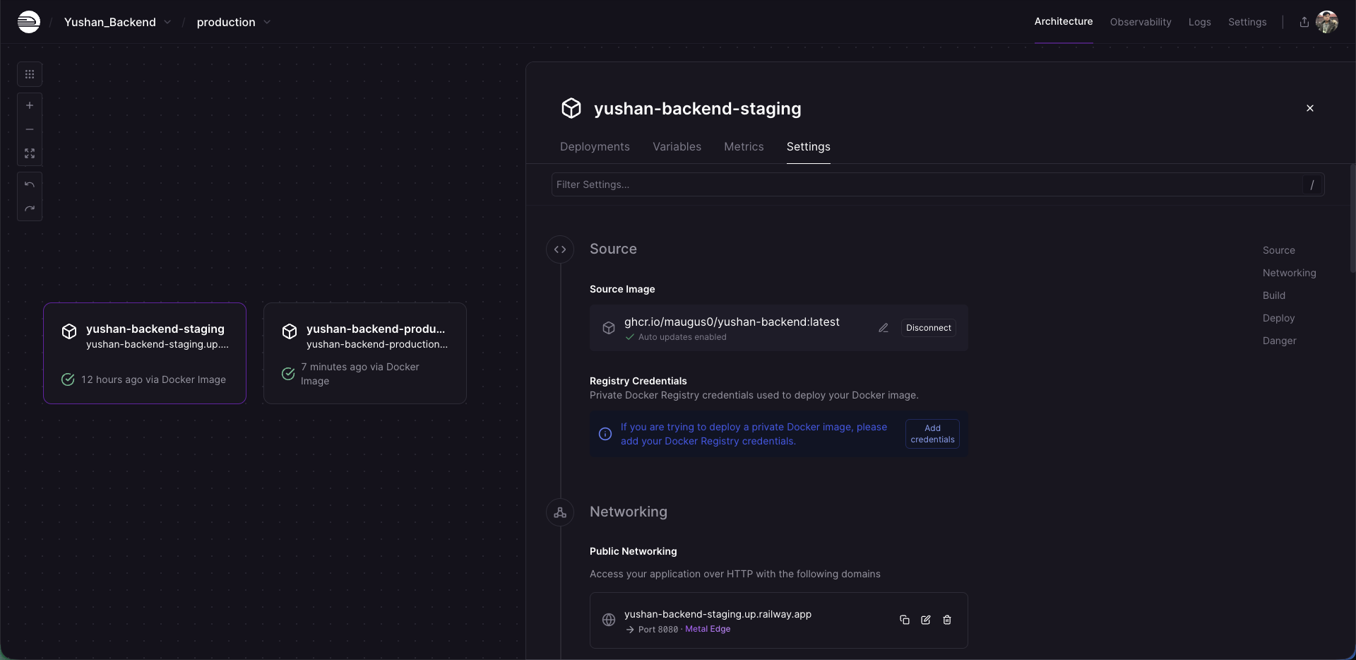
Railway Setting

Slide 43
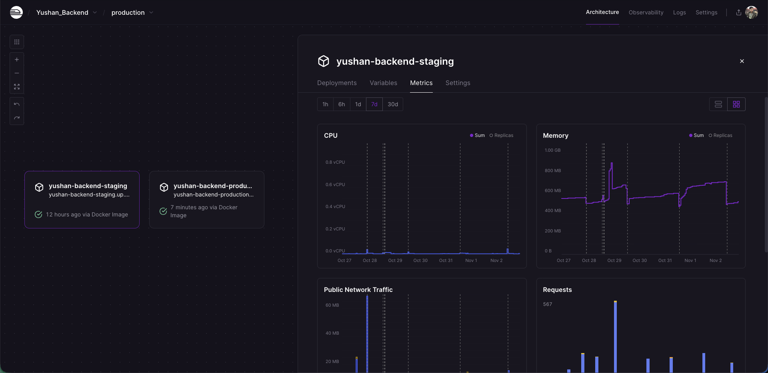
Railway Metrics

Slide 44
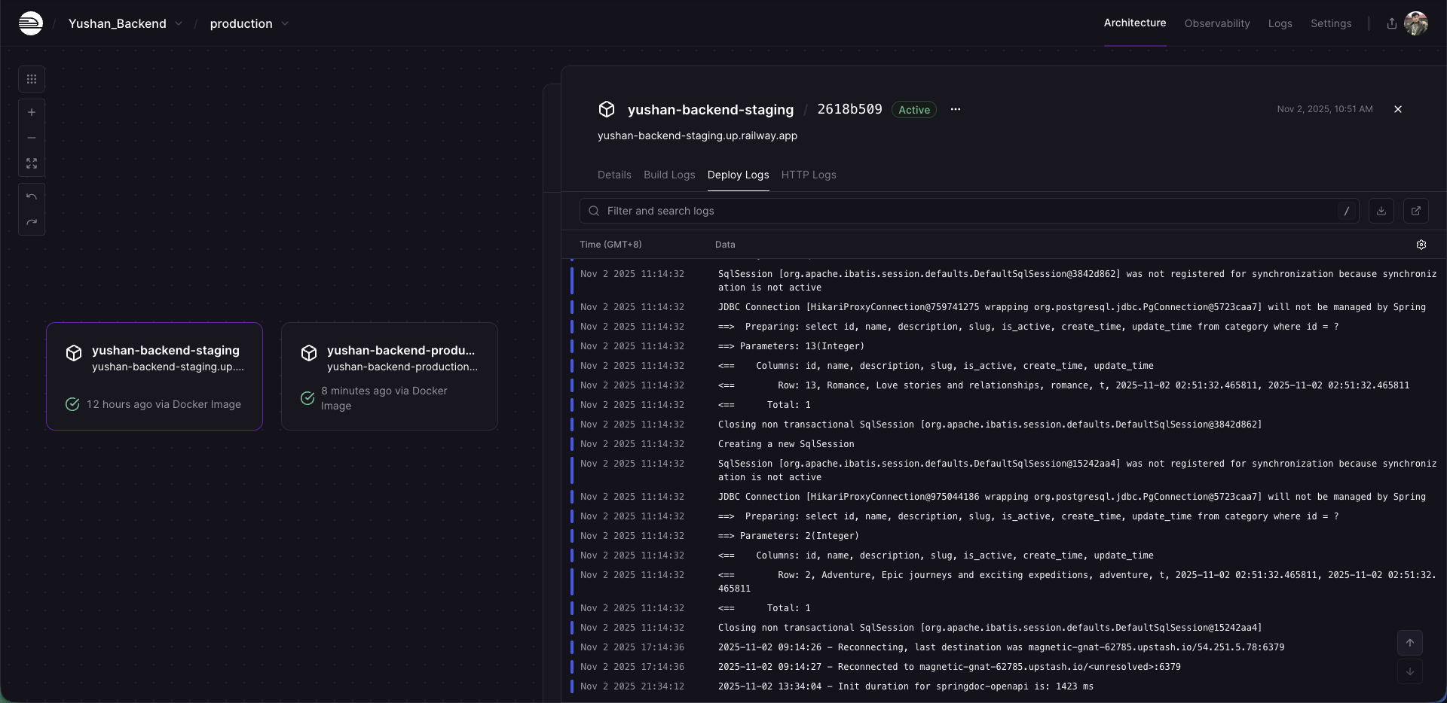
Railway Logs

Slide 45
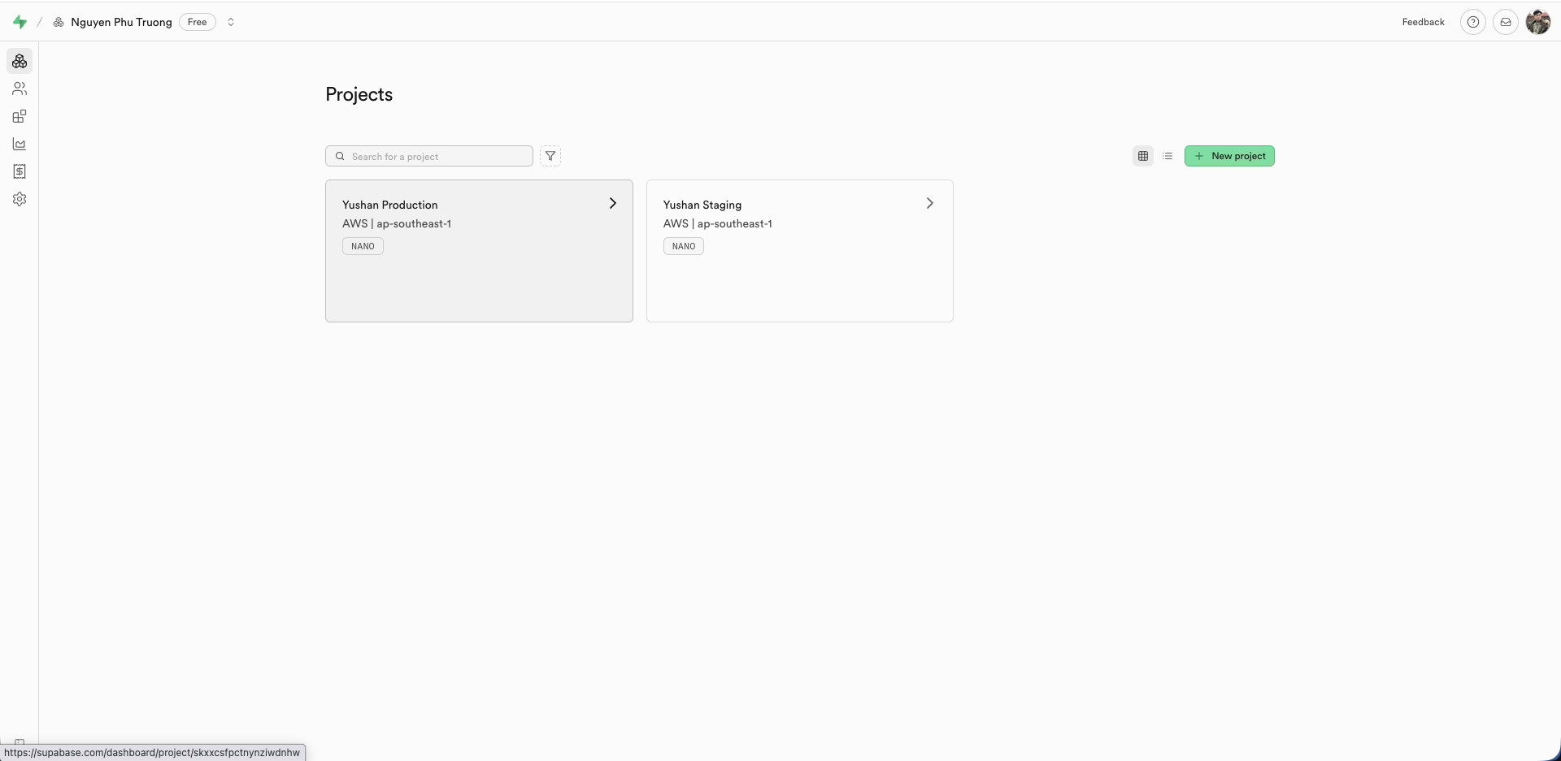
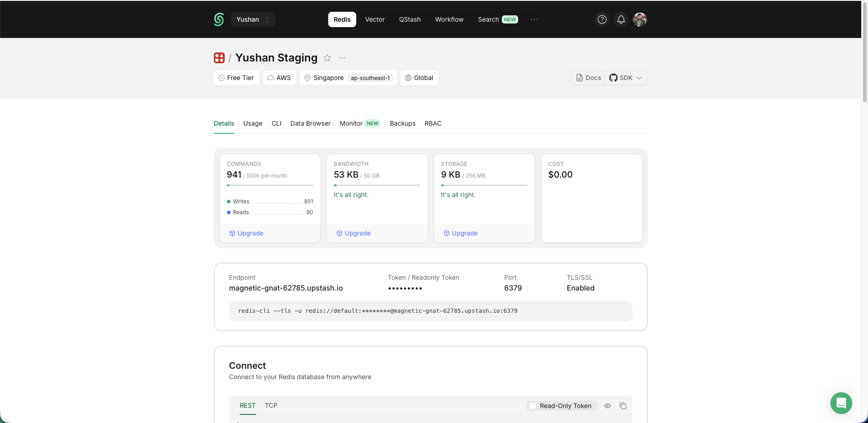
Supabase and Upstash Dashboard

Slide 46
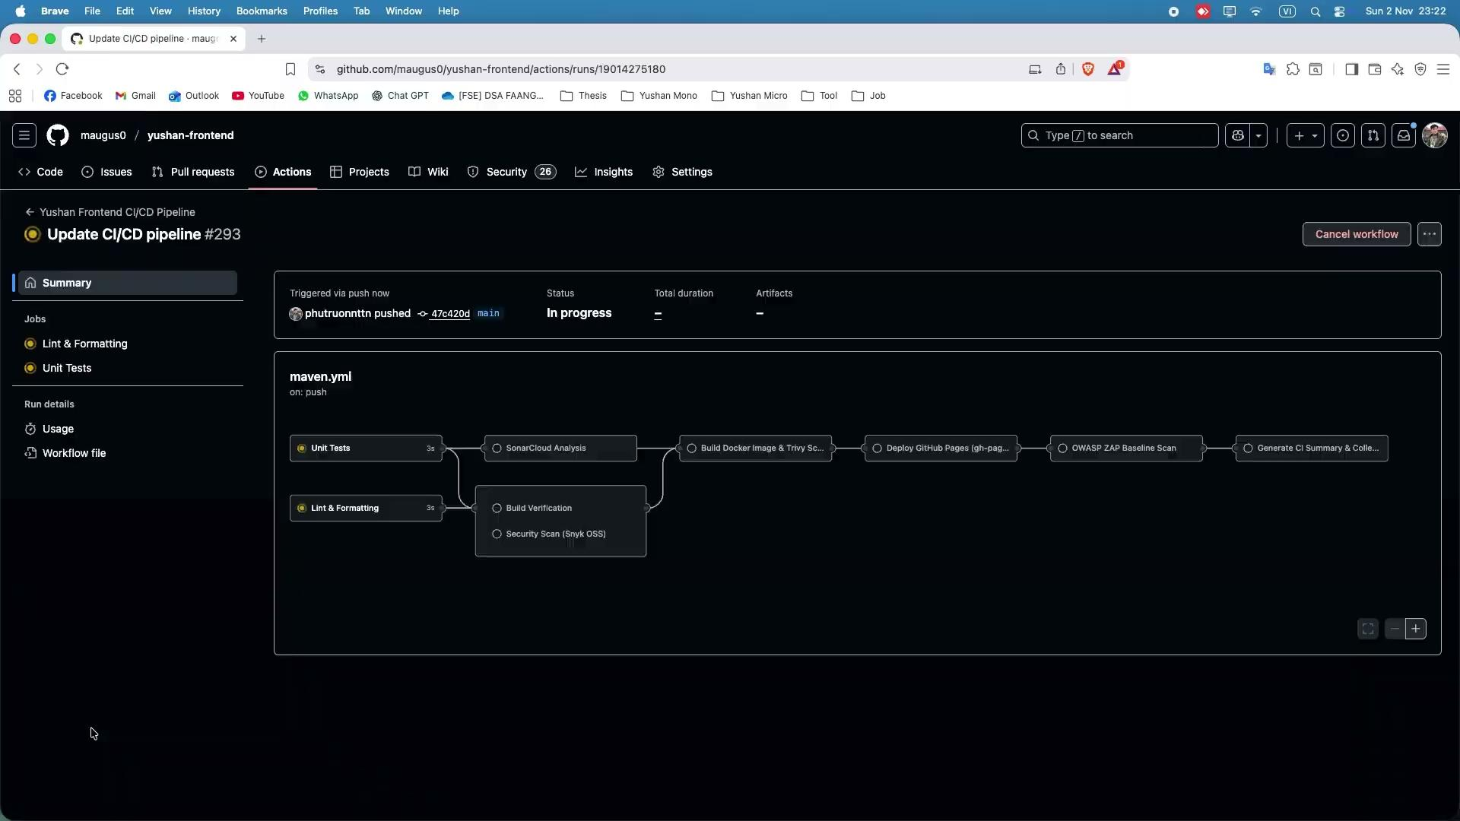
5. Demo CI/CD Pipeline - Demo Frontend

Slide 47
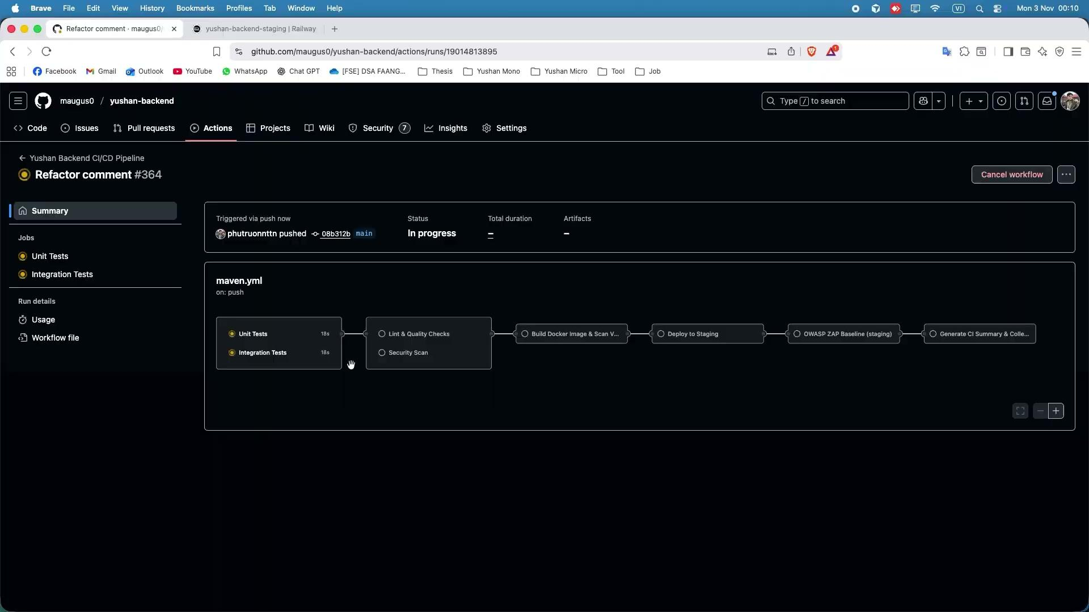
5. Demo CI/CD Pipeline - Demo Backend

Slide 48
Project Demo Presentation

Slide 49


